Slide 1
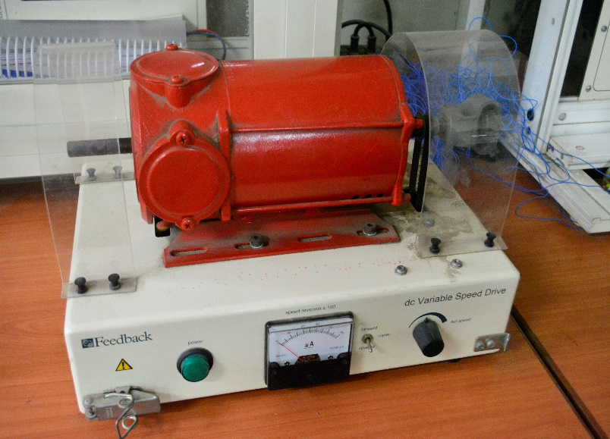
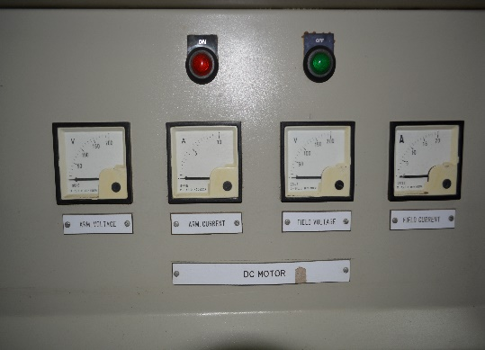
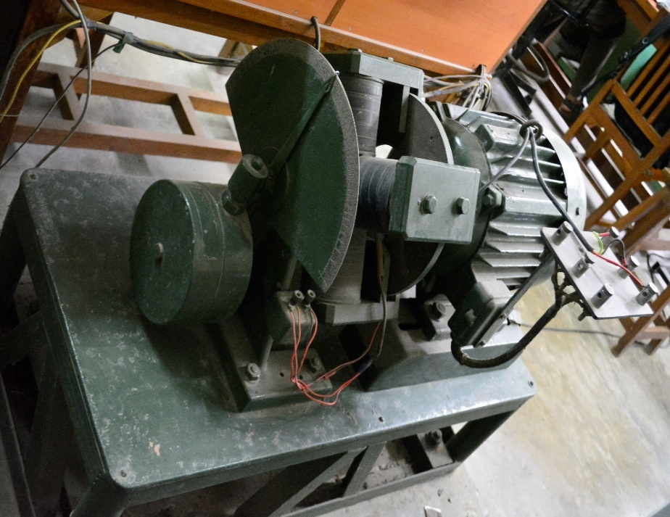
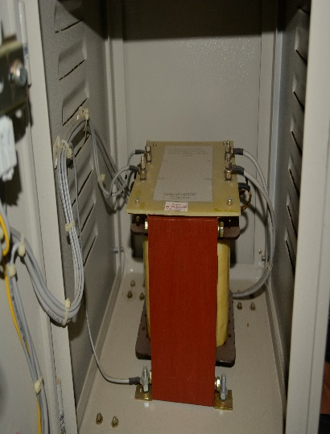
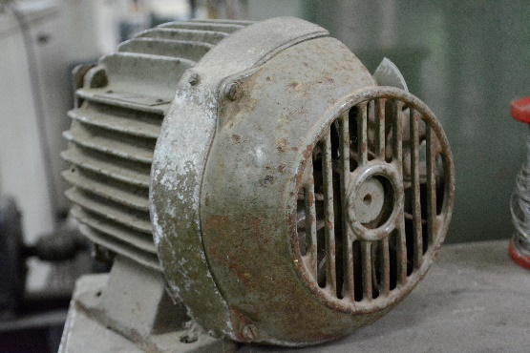
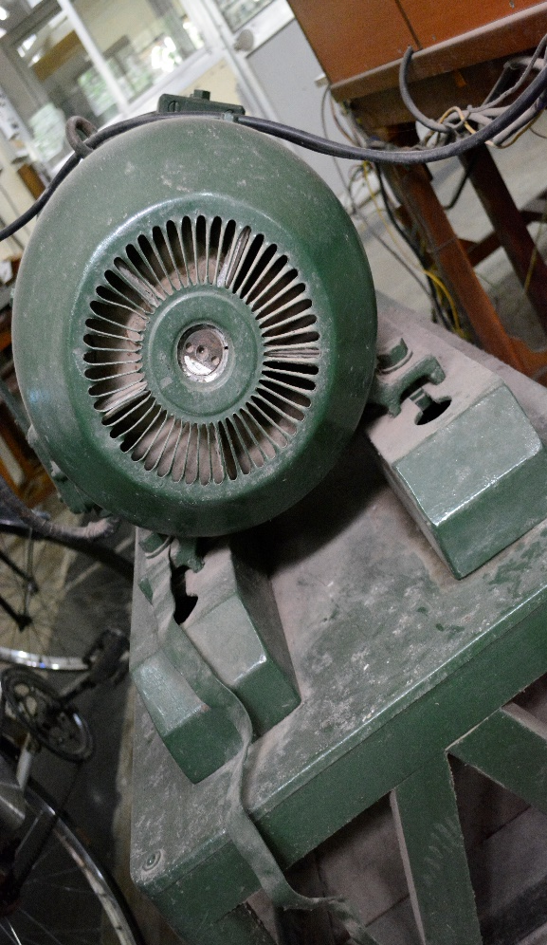
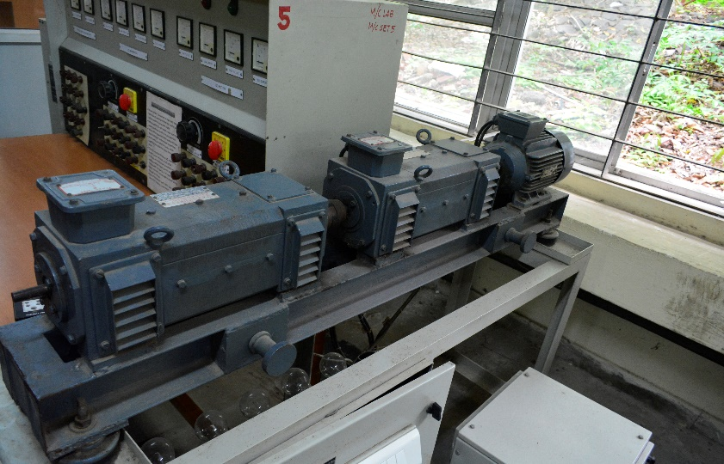
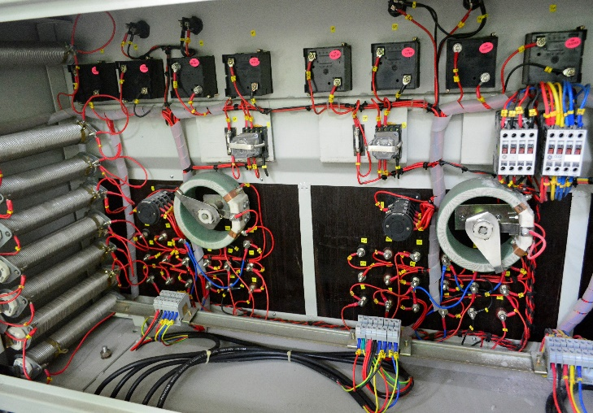
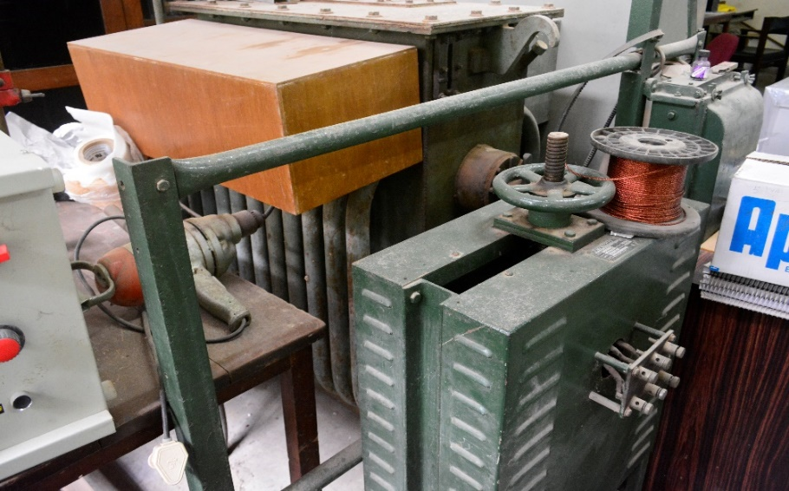
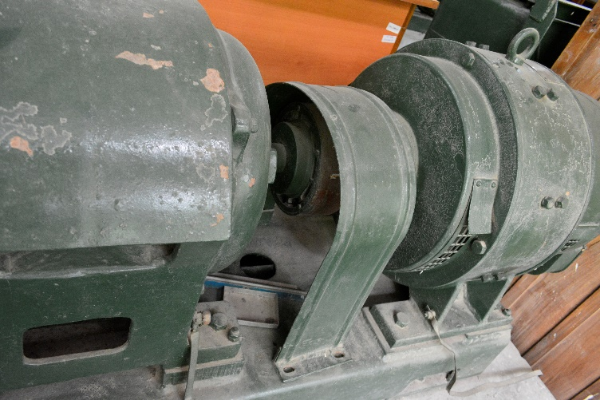
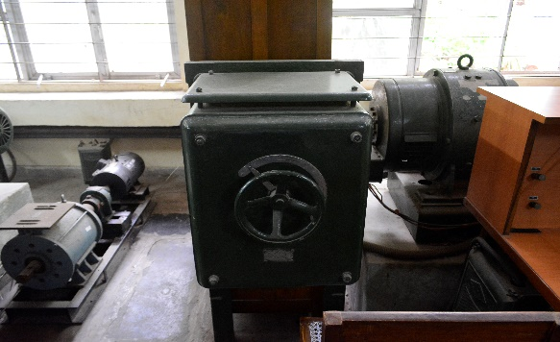

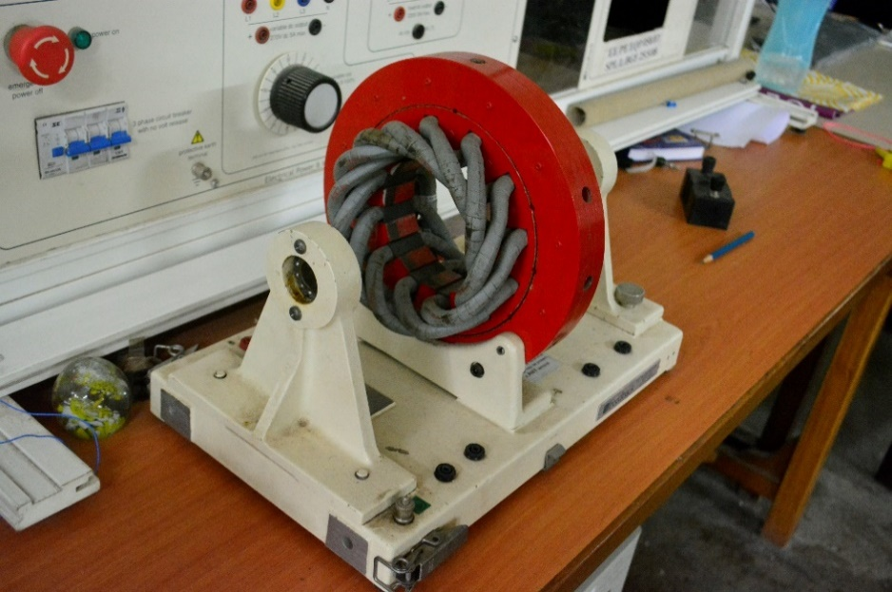
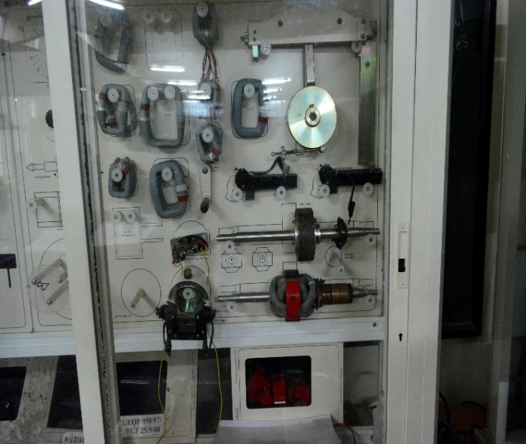
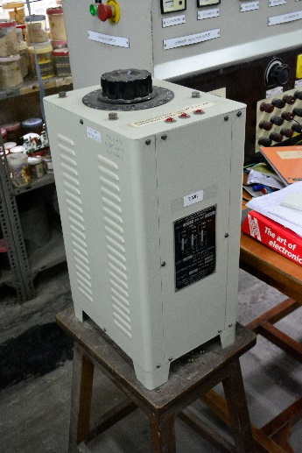
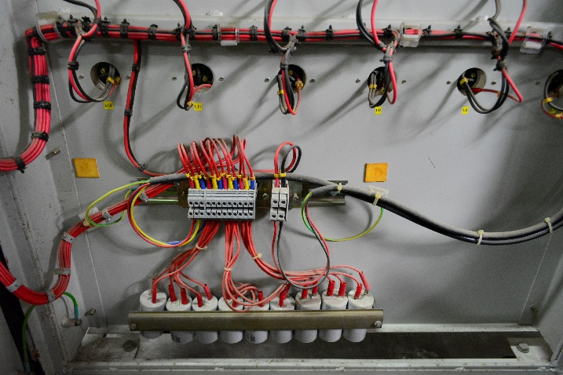
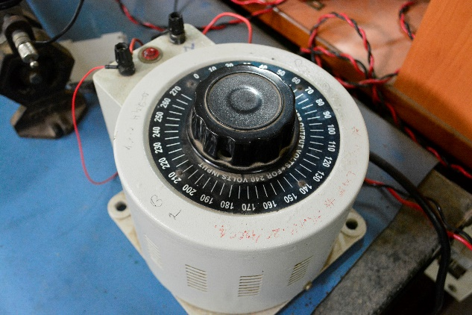
EN 319
Experiment no. 1
Vijay A S

Slide 2
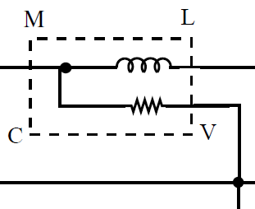
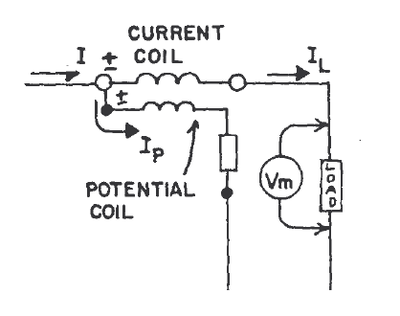
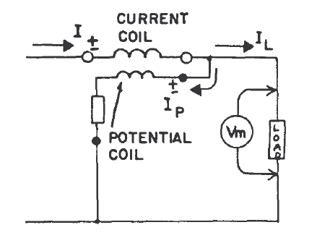
Experiment 1: Power measurement in balanced 3 phase circuits and power factor improvement
Source
Load
Wattmeters : Voltage and current coils, 2 types of connections

Slide 3
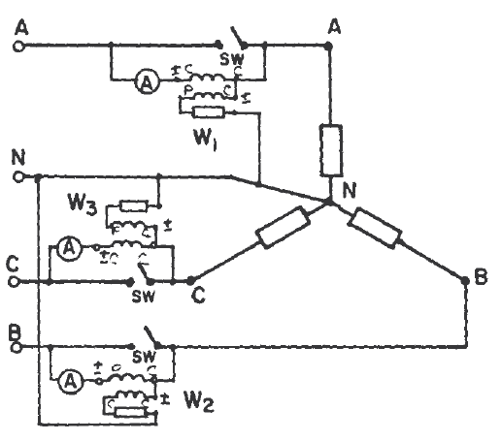
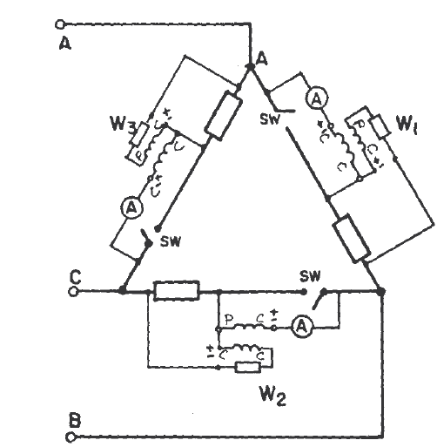
3 phase power measurement
Delta connected load
Star connected load
Three phase systems: 3 Wattmeters (one for each phase)

Slide 4
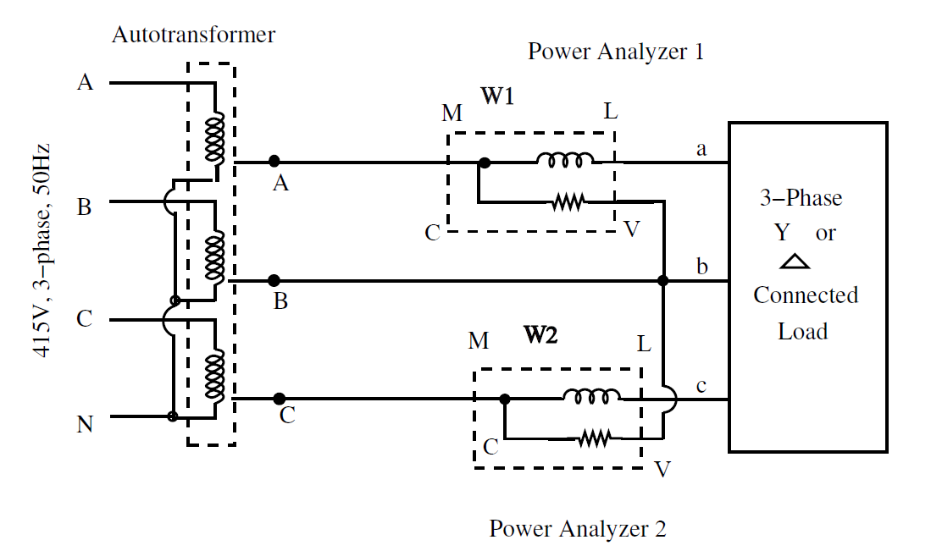
Experiment 1: formulae for 2 wattmeter method
Total real/average power P (W) consumed:
Total reactive power Q(VAR) consumed:
for A-B-C sequence
for A-C-B sequence
Power factor:
2 Wattmeters : Universal for
balanced and unbalanced loads
or

Slide 5
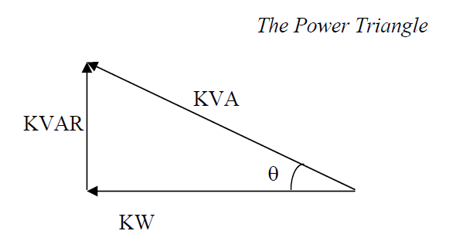
Experiment 1: power factor improvement
Following are benefits of unity power factor:
Lower capacity of equipment
Lower conductor size
reduced system losses/ high efficiency
Increased voltage level (better regulation)
Lower utility electricity bill
consumers of Reactive Power (inductive loads) decrease power factor:
Transformers
Induction motors
Induction generators (wind mill generators)
High intensity discharge (HID) lighting
Arc lamps, industrial furnaces
sources of Reactive Power increase power factor:
Capacitors
Synchronous motors (overexcited)
Phase advancers
Power electronics based compensators (shunt active power filters and PWM rectifiers)

Slide 6
Experiment 1: mind exercises
Following types of methods possible for power measurement in 3 phase circuits:
One wattmeter method
Two wattmeter method
Three wattmeter method
What are the cases/circuit conditions in which these can be used?
Is the power factor formula for the 2 wattmeter method valid for unbalanced case as well?
Can inductors be used for pf improvement and why?

Slide 7
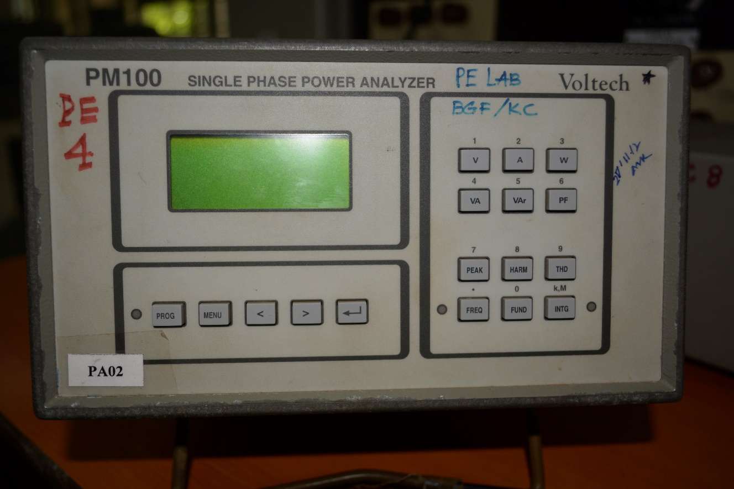
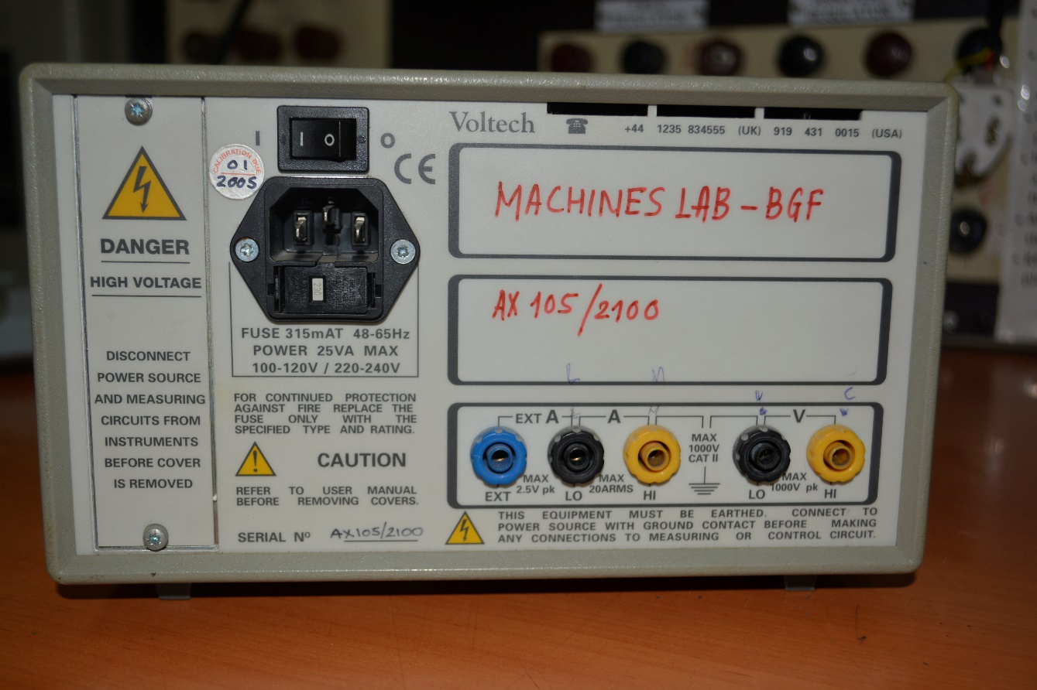
Equipment details
POWER ANALYSER
MFD BY: VOLTECH INSTRUMENTS
MODEL NO: PM100
VOLTAGE RANGE: 2V rms to 1000V pk
CURRENT RANGE: 20mA rms - 20A rms
MEASUREMENT SELECTION
PM 100 : REAR VIEW
PM 100 : FRONT VIEW
PROBES FOR VOLTAGES
AND CURRENTS
* Refer to manual for detailed ratings

Slide 8
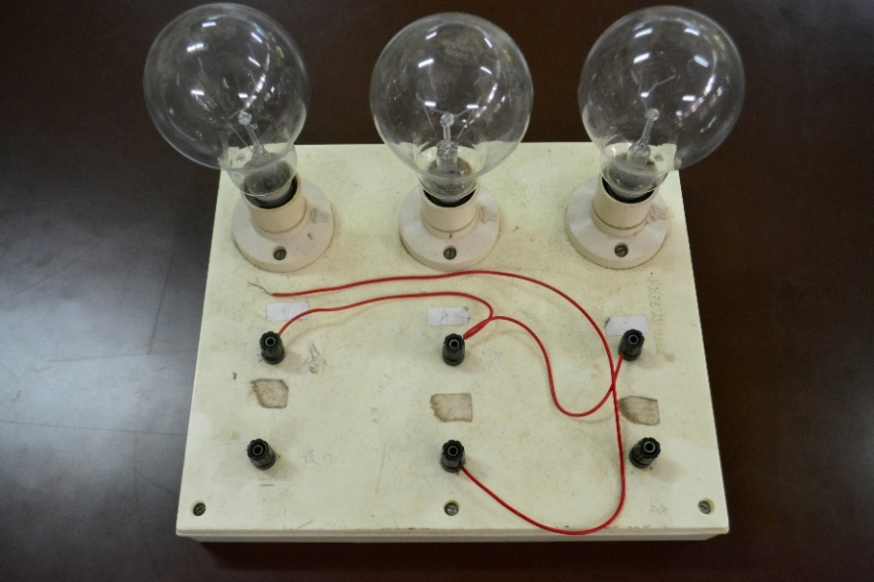

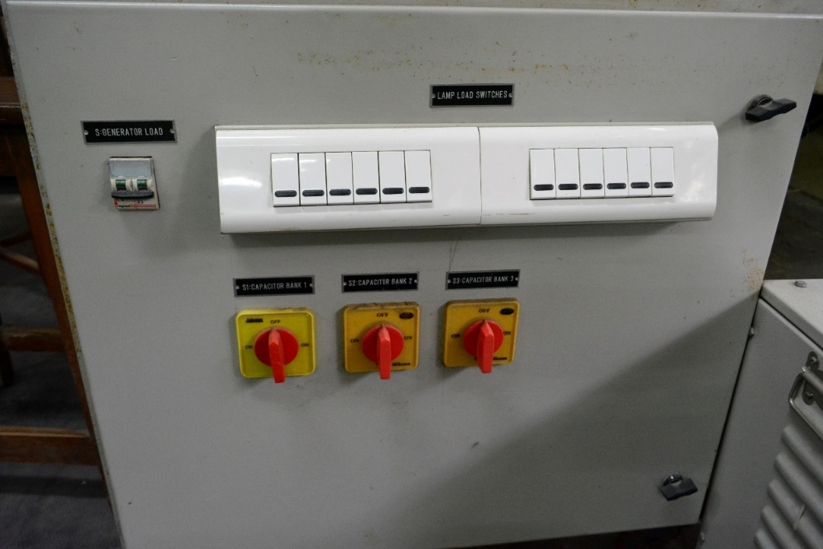
3phase bulb load
to be connected
in star or delta
SW1
SW2
SW3
3phase capacitor bank switches and panel
(for pf improvement) each condenser is rated 10microF
*Note the ratings of the bulbs and condensors
before the expt is conducted

Slide 9
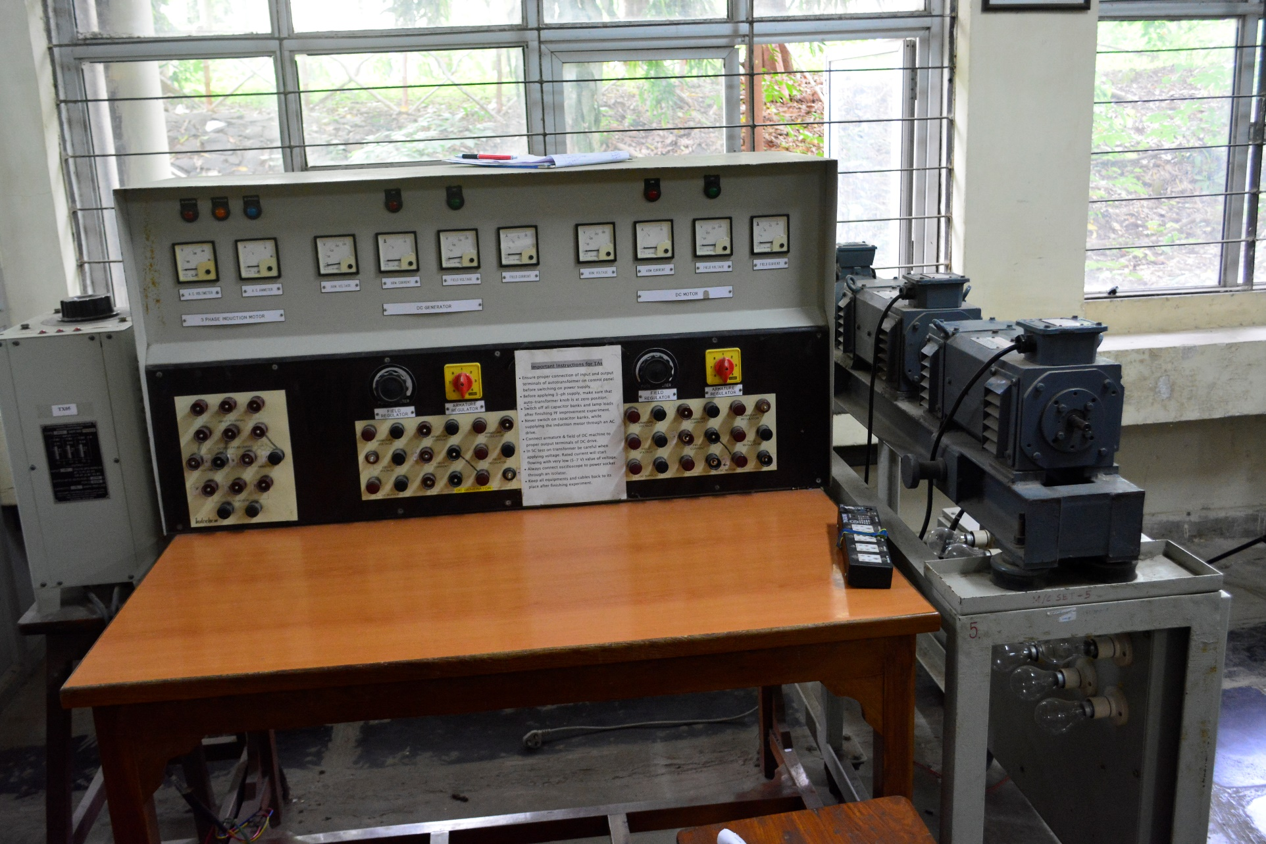
Control panel with meters
for monitoring
3 phase IM
3 phase ac variac
DC MC1
DC MC2
DC Gen load
Electrical panel for DC Gen, DC motor & 3ph IM ( common shaft)

Slide 10

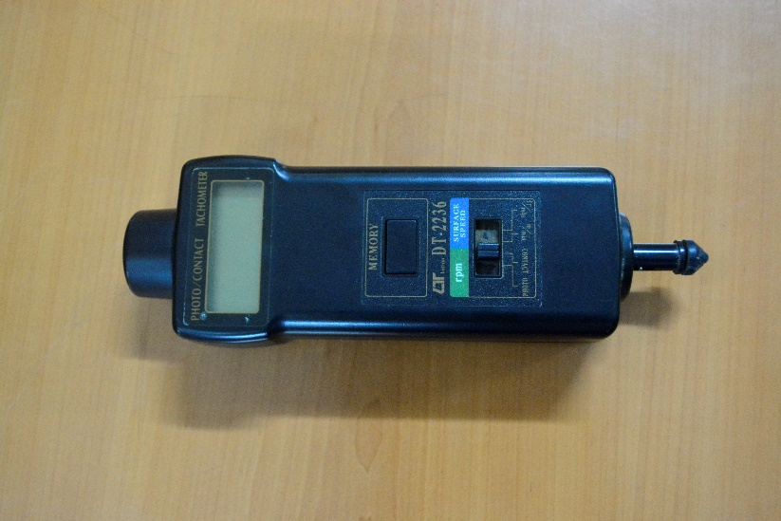
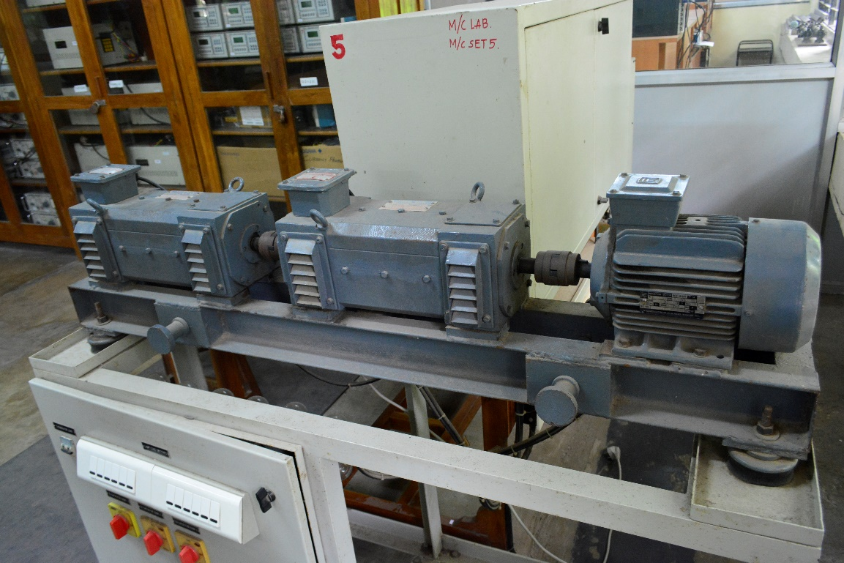
TACHOMETER
MFD BY:
LUTRON ELECTRONIC
RANGE : 5 to 99,999 RPM.
ACCURACY: ± ( 0.05% + 1 digit )
Electrical panel ( inside )
Tachometer for speed (rpm) measurement
DC Motor
DC Generator
3 phase Induction Motor
Bulb load switching panel
Common shaft

Slide 11

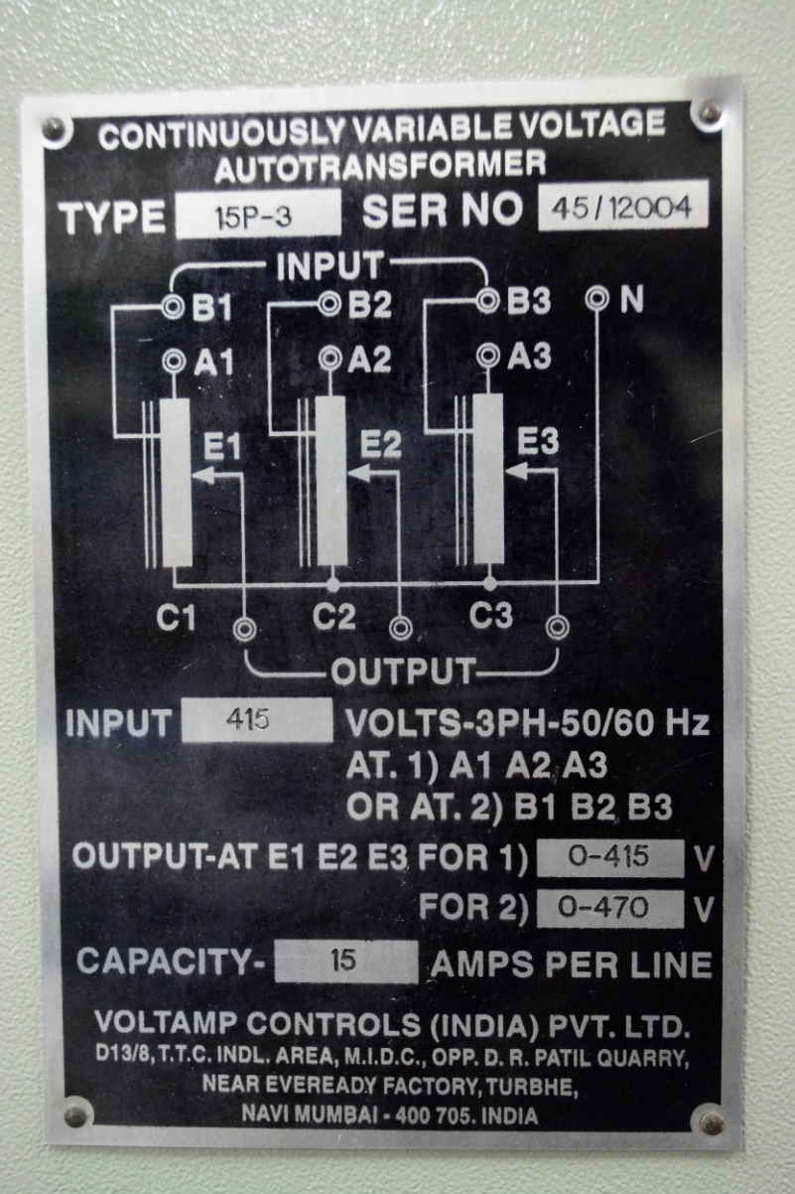
3 PH. VARIAC
MFD BY:
VOLTAMP CONTROLS

Slide 12
Lab Reports (1 per batch)
Aim/objective
Name plate details
Procedure: In your own words, explain what has to be done, not instructions as given in the manual !
Diagrams properly labeled (in pencil)
Readings in tabulated form (1 for bulb load, 1 for IM)
Sample calculations, Observations, conclusions
Answers for questions in the manual
Mention clearly the date, Batch no., Roll no. and Expt no. on front sheet !
SL no. | V1 | V2 | I1 | I2 | W1 | W2 | TOTAL Power(W1+W2) | Power factor (formula) | Power factor (calculated)

Slide 13
Links
http://www.electrical4u.com/measurement-of-three-phase-power( 3 phase power)
https://www.youtube.com/watch?v=DIGqBb3iZPo (elec bulb)
https://www.youtube.com/watch?v=HqZtptHnC2I (why 3 phase power)
https://www.youtube.com/watch?v=MnH_ifcRJq4 (3 phase explained)
https://www.youtube.com/watch?v=C0ahQkkeSVo (3 phase circuits)
https://www.youtube.com/watch?v=3DyLxDQHRpE (power factor)
https://www.youtube.com/watch?v=dPFKcUxbNuQ (power factor improvement)
https://www.youtube.com/watch?v=Z_ymSN6Vi2Y (Energy 4 Business pfc explained)
https://www.youtube.com/watch?v=5Mu42TzHy8M (production of elec. machines)
https://www.youtube.com/watch?v=uwFvGZcjQME (making of a cable)
https://www.youtube.com/watch?v=hIkNY5xjy5k (500KV Substation arc)
https://www.youtube.com/watch?v=yy3hKtuY9Bg (loss of 1 phase in a 3 phase system)
https://www.youtube.com/watch?v=ec0TjyE3Vpo&index=8&list=PLpQj-5U_XGcHgHWbsVSYA_9avssRsgx4j
(3 phase animation)

